Slide 1
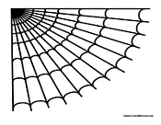


Itsy Bitsy Spider
By Katerina Boetta

Slide 2



Slide 3







Slide 4


Slide 5






Slide 6





