Slide 1
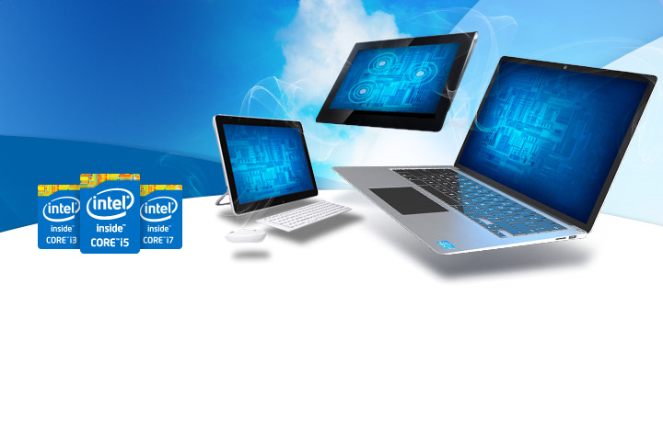
Unit 4—Part A 2nd Evaluating & Purchasing a Computer
Computer Technology
(S 1 Obj 2-3 and Obj 3-2)

Slide 2
Processor Speed
Hertz (Hz) = Refers to the speed of the processor (clock-speed)
Processing speed is measured in HERTZ
Hertz represents how quickly the CPU can interpret instructions from the operating system and applications.
One kilohertz (KHz) = one thousand cycles per second
One megahertz (MHz) = one million cycles per second
One gigahertz (GHz) = one billion cycles per second.
The typical CPU today runs in the 3 GHz + range

Slide 3
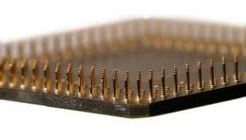
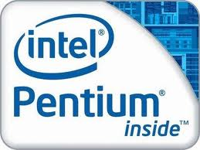
Type of Processors Continued…
Pentium: A brand of processors created by the company Intel intended for middle to high-end computers
Pentium is originally derived from the Greek word pente meaning "five" (Intel's 5th generation processors)

Slide 4
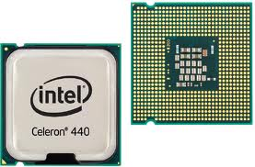
Type of Processors
Celeron Processor
A low to middle-end computer processor used for basic applications:
document processing (e-mail, Internet and basic document processing) simple photo editing and Internet browsing
Targeted for budget computers

Slide 5
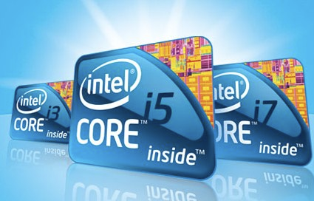
Multi-Core Processors
Watch the video below to learn more about the popular Intel i3, i5 and i7 Core Processors
******Watch embedded video on my site for this info.

Slide 6
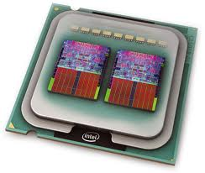
Multi-Core Processors
To re-cap what the video taught, a multi-core processor is a single chip that contains two or more independent central processing units called "cores"
Dual Core = 2 cores
Quad Core = 4 cores
Hexa-Core processor = 6 cores
Octa-Core processor = 8 cores

Slide 7
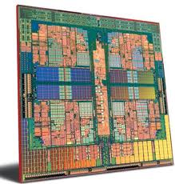
Advantages of Multi-Core Processors
Multi-core processors allows the processor to operate at a higher clock-rate
The speed of a processor doesn't only depend on Hertz, it also depends on how many "cores" the processor has.
Each core is like a separate processor, so a dual core processor at 2 GHz is as good as having two processors at 2 Ghz working at the same time (2Ghz X 2GHz).

Slide 8
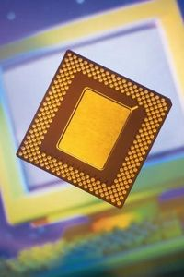
The difference a few years makes…
1981 Intel CPU = 8 MHz
1991 Intel CPU = 33 MHz (4 times faster)
A CPU today can do a job in 1.5 seconds that took the original Intel CPU 10 minutes to process!
Now that is PROGRESS!

Slide 9
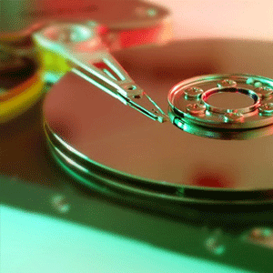
Storage Capacity
Hard drive size and amount of RAM have a major impact on computer performance
Not enough of either one can destabilize a computer or cause you to be unable to run some programs
So, how much is enough?

Slide 10
Get Enough Storage Space
Text documents, pictures and music generally don’t require much space alone
The larger your collection, the more storage capacity you will need
Storage capacity is measured in Gigabytes and Terabytes
When determining storage capacity, consider:
Cloud storage
External storage devices

Slide 11
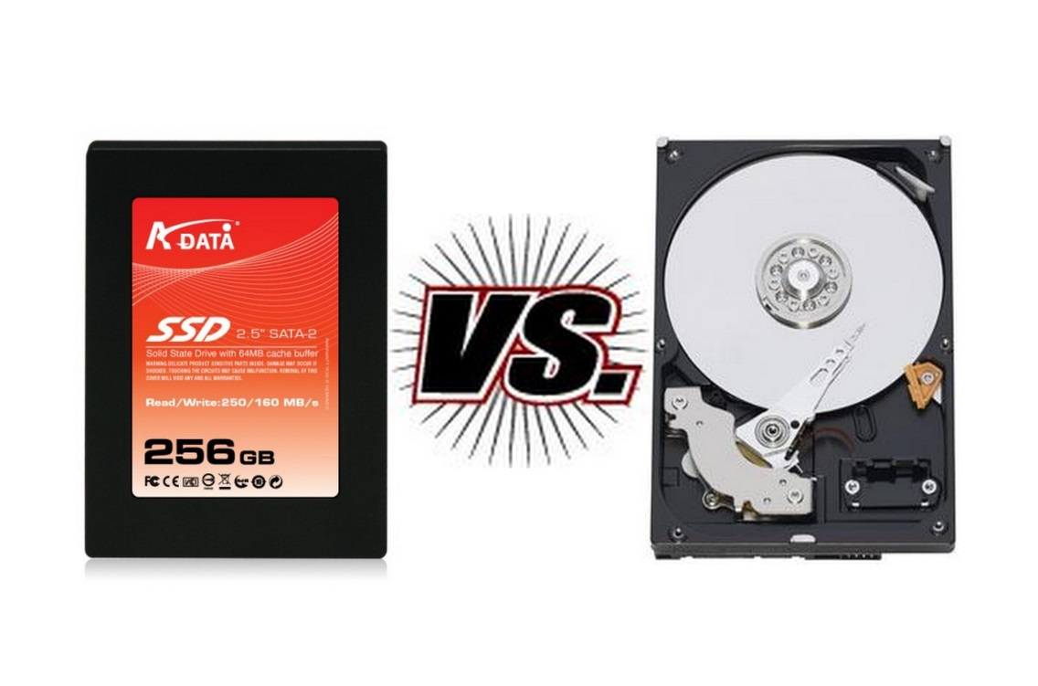
Storage Space
Solid state drives are extremely quick, but expensive (10 to 17 times more than hard dives)
Most people can’t afford to use them as their only form of storage
Hard drives are the best bet for storing lots of data
If you have money to spend, buy both
A 120 GB solid state drive is large enough to fit your operating system and a few critical programs
Then add a 500 GB to 1 TB mechanical hard drive for storage
If your budget is tight, go with the fastest hard drive you can afford (usually 7,200RPM rotations per minute)
Solid State Drive
Hard Drive

Slide 12
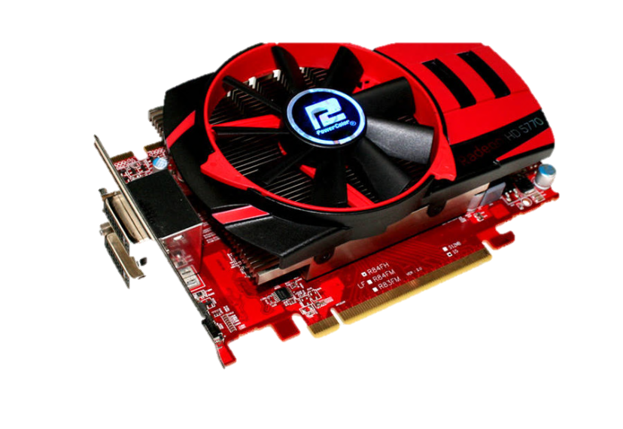
Video Card
Video cards refresh the little red, green, and blue dots (pixels) on your screen many times per second
The more it refreshes, the more solid your screen appears
Integrated graphics cards are built into the motherboard
Gamers usually choose to purchase a “discrete video card” which is a separate video card that plugs into the motherboard because it contains its own source of memory and consumes less RAM

Slide 13
Operating Systems
The biggest decision is choosing an operating system
Once you pick an OS, you are committed to learning the rules of that OS
So what is it going to be?
Windows
Macintosh
Linux
Other

Slide 14
Windows
It’s a Windows world out there (98% of the market share)
Vast number of products available
Windows support is easy to come by from a wide variety of sources
Inexpensive repair and upgrade services available

Slide 15
Macintosh OS X
The most intuitive user interface on the market today
Less number of products available
Vendors may not produce Mac versions of their product
Mac versions are produced months or years after the Windows product
Support from Apple is top-notch
Macs are more expensive than comparable Windows machine
Better for graphical design and video editing applications

Slide 16
Linux
Powerful and sophisticated operating system that is FREE!
Thousands of people around the world spend their free time working on various versions of Linux called “ditros and” then make them available for free (open source)
Very few people use Linux
Difficult to find software because most vendors don’t make a Linux version of their software

Slide 17
Other Factors to Consider
Hardware
Monitor
CD/DVD drive
Bundled Software (pre-installed software)
Warranties
Most computers come with a 1-3 year warranty
Is free telephone and online support included

Slide 18
1/3/5 Rule
Whatever you buy today will be beaten by a new product one year from now
It will be common technology three years from now
It will be obsolete five years from now
This applies to everything, even if you purchase a fancy, top of the line computer
Future proofing is not possible, therefore, you should only buy what is adequate for right now
You will save a lot of money if you keep this simple rule in mind

Slide 19
Conclusion
PC Hardware is a complex topic
Educate yourself on your computer needs and computers available BEFORE you start looking for a new computer
Many people break the general hardware rules and buy a computer that is faster and has more storage capacity than they need just because it excites them!
There is nothing wrong with enjoying your PC—just keep your budget in mind

Slide 20
If Time Permits…
Visit Consumer Reports Website
Watch the video called Computer Buying Guide
Finally scroll below the video and read through Consumer Report’s suggestions in choosing the type of computer and operating system that best suits your needs

Slide 21
Works Cited
http://www.pcmag.com/article2/0,2817,2382326,00.asp
http://www.makeuseof.com/

